Slide 1

Alzheimer’s Disease Diagnosis
USING MACHINE LEARNING MODELS
PRESENTED BY: HAMZA IMRAN MIRZA

Slide 2
Table of contents
3
Introduction/Research
4
Challenge/Hypothesis
5
KDD Goals
6
RF Classifier Importance
7
Super Vised Learning Models Continued
8
Evaluation Results
9
Findings and Conclusion

Slide 3
Introduction
Alzheimer’s Disease is a neurodegenerative disease that affects people usually 65 or older. It slowly destroys memory and thinking ability.
The disease is hard to diagnose as symptoms appear when it has already progressed (Late onset), At this stage the brain has already lost significant amount of neurons and Alzheimer’s is irreversible.
Hence it is necessary to diagnose the disease in its early stages.

Slide 4
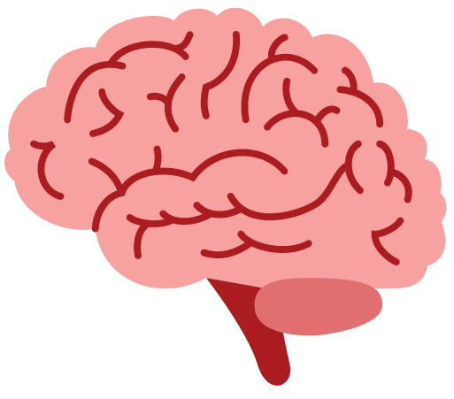
Challenge / Hypothesis
Diagnose the disease effectively and timely.
Classify the dataset into “Diagnosed” and “ Not diagnosed” using ML models.
When analyzing the dataset focus on high impact factors rather than generic medical factors
Separate the high impact diagnosing factors.
Hypothesis: “What metric or attribute or factors can help us better predict the diagnosis/development of Alzheimer’s disease in patients” and to further prove the hypothesis, I will be creating machine learning models that will train on these specific factors and classify patients with accuracy.

Slide 5
KDD
Goals
The dataset being used has 35 attributes, The assumption is that not all 35 attributes will have the same impact on the outcome (Diagnosis). Hence the KDD goal is to find out the high impact variables. To do that:
Use a Random Forest Classifier Model to rank the importance of each variable.
Create a new Data Set consisting only of these high impact variables.
Then in order to test and support the hypothesis and the result of RF classifier and to correctly classify the dataset:
Train and Test a Decision Tree Classifier on the new dataset
Train and Test a KNN classifier on the new Dataset.

Slide 6
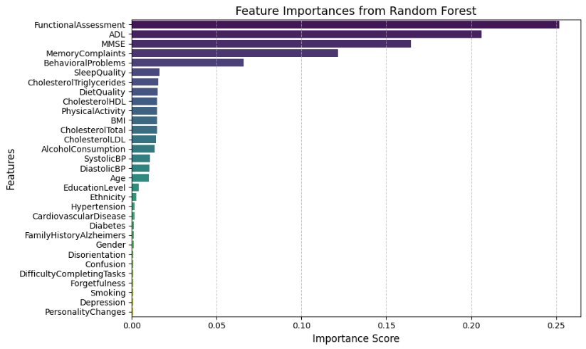
RF Classifier Importance
An RF classifier model is trained on the original dataset to find the most important features:
The number of features are 32 (15 are numerical and 17 are categorical)
Since this is a binary classification, The label belongs to two classes 0 (not diagnosed) and 1 (diagnosed)
The size of train/test set is dynamic as I used Stratified K fold with a random state that changes with each iteration of validation. Hence during training and testing the dataset’s size changes as compared to previous iteration.
The output of the RF classifier that ranks features based on their importance is visualized in the plot

Slide 7
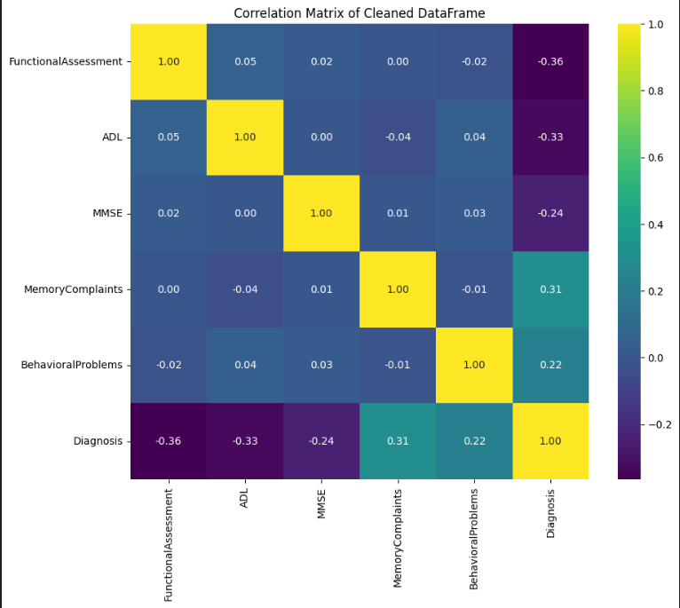
Correlation
Matrix
Here is a correlation Matrix that shows the correlation between the most important features found from the RF classifier. This helps us visualize the relation between these features and the output (Diagnosis)

Slide 8

Supervised Learning Models (Cont.)
Next I trained two Supervised Machine Learning Models:
Decision Tree Classifier
In order to classify the label into two classes 0 (No Alzheimer’s) and 1 (Yes Alzheimer’s)
The number of features are 5 ( MMSE, Functional Assessment, ADL, Memory Complaints, Behavioral Problems)
The size of test set was 16% and train set 84%
KNN Classifier:
The KNN classifier is also trained on the same cleaned data set and also uses the same train test split.
The data contains same number of features and the label has to be classified into the same two classes.
Cross validation was performed to find the best value of n for KNN.
The reason for training these two supervised learning models is to, 1. Predict the outcome of the target variable by classifying it in the two classes. 2. To support the outcome of RF classifier that, yes these are the best variables that can help us in better classifying and predicting Alzheimer’s

Slide 9
Evaluation
The evaluation metrics and their results for all three supervised models are given below:
RF Tree Classifier:
The model has a mean accuracy of 88.6% over 5 iterations of 5-fold CV with 5000 trees for each iteration.
Moreover the features are ranked by calculating the mean of their RF importance score.
Decision Tree Classifier:
To evaluate the decision tree classifier more than one metrics are used.
Accuracy = 96%
Average F1 Score = 91%
The confusion matrix is given in the figure and AUC score is 0.97 and the ROC curve is also given.
KNN Classifier:
KNN accuracy = 84%
ROC AUC = 97%

Slide 10
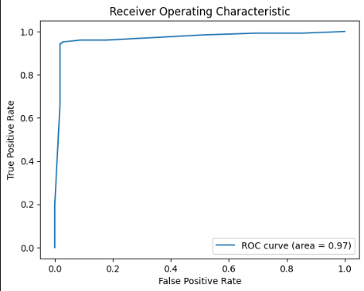
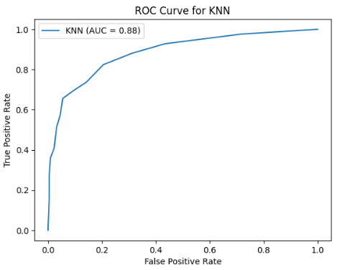
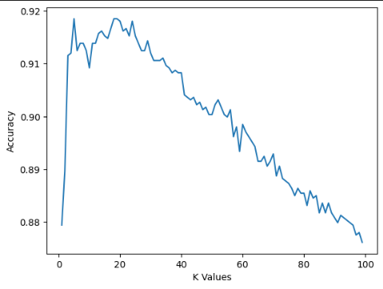
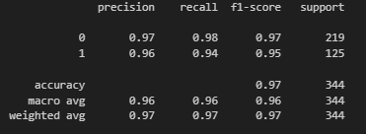
Graphs
Decision Tree Classifier
KNN Classifier

Slide 11
Conclusions
According to the findings we can conclude that Clinical Tests like Functional Assessment and MMSE and Patient’s own ADL (Activities of Daily Life) , Behavioral Problems and Memory Complaints (Subjective to the Patient). These 5 factors are much more effective and impactful in predicting the presence or diagnosing the patient with Alzheimer’s disease. Whereas other factors like Age, Obesity, Heart Disease and medical factors can play a role in the patient acquiring Alzheimer’s but they are less effective in predicting the outcome i.e. Diagnosing Alzheimer’s.
Moreover, Focusing mainly on these features we can train highly accurate machine learning models that can classify the dataset and correctly predict presence or absence of Alzheimer’s disease.
The model best suited for this task is the decision tree classifier with accuracy of 96% and there is no problem of overfitting and underfitting as the model is performing exceptionally well on both the training data and testing data.

Slide 12
Thank you

